Slide 1

CMP1101:
TRANSISTORS

Slide 2
ANNOUNCEMENTS
LABS
iLabs needs you to complete an already loaded lab assignment by end of next week – Nov 3rd.
CAT1 Results
Due Friday, Nov 27th.
CAT2 or extensive homework
Simulation project.
Not much time left to finals period.
Proposal: Do it as extra credit.

Slide 3
WHAT IS A TRANSISTOR
A semiconductor device that switches or amplifies electrical signals or electrical power.
A transistor is a fundamental building block of electronic circuits.
The name is coined from the combination of two words “transfer” and “resistor”
Early research in the creation of transistors was started in Bell Labs after the successful use of semiconductor devices in the U.S.A radar system.

Slide 4
SEVERAL FORMS OF TRANSISTORS
The basic junction transistor is derived from the operation of the p-n junction.
The rectifying characteristics of the p-n junction that allows for the flow of current in one direction and blocks it in the opposite direction.
Arranging two p-n junctions in opposite directions to each other is the basis for the
n-p-n junction transistor
p-n-p junction transistor
These kinds of transistors are popular referred to as the bipolar junction transistors because:
both electrons and holes must coexist in the middle layer for some time during the operation of the transistor.

Slide 5
BIPOLAR JUNCTION TRANSISTOR (BJT)
A three layer device constructed from two diode junctions joined together
One p-n junction in the forward bias
Second p-n junction in the reverse bias
Two main types of BJTs exist
NPN transistor
PNP transistor
BJTs are current regulating devices that control the amount of current flowing through them in proportion to the amount of biasing voltage.
It thus acts like a current-controlled switch.

Slide 6
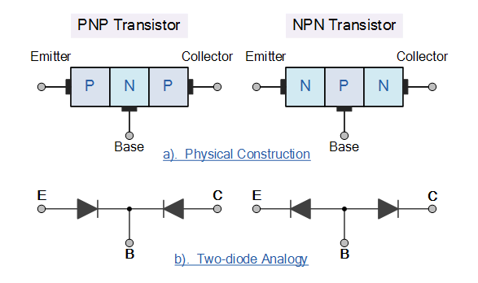
BJT PHYSICAL CONSTRUCTION

Slide 7
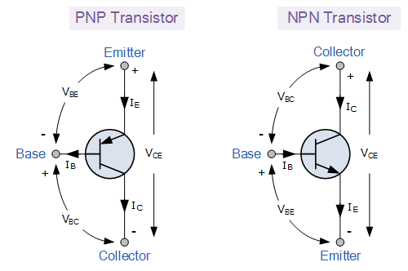
BJT CIRCUIT SYMBOLS

Slide 8
BJT OPERATION
The base-emitter junction is always forward biased while the base-collector junction is always reverse biased.
For either the NPN or PNP BJTs, the standard current equation is given by
I_{E} = I_{B} + I_{C}
The NPN transistor requires the base to be more positive than the emitter while the reverse is true for the PNP transistor.
Thus the biasing and polarity of the power supplies for each type are different.
Otherwise, the principle of operation of a PNP and an NPN is exactly the same.
Since the BJT is a 3 terminal device, there’s 3 different ways (configurations) of connecting it within an electronic with one terminal being common to both the input and the output.

Slide 9
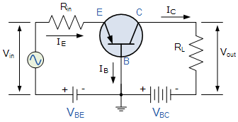
BJT CONFIGURATIONS
Common-base: has voltage gain and no current gain.
Also called the grounded base, the base terminal is grounded or can be connected to some fixed reference voltage point.
The base connection is common to both the input and the output.
The input signal is applied between the base and the emitter while the output signal is picked between the base and the collector.
The input current through the emitter is larger than (sum of) the base and collector currents thus this configuration attenuates the input signal.

Slide 10
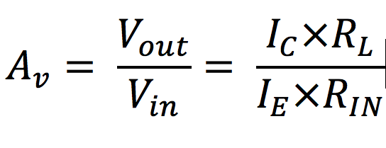
Common Base Configuration Contd.
The Common-base configuration is:
A non-inverting voltage amplifier circuit, i.e V_{in} and V_{out} are in-phase.
Application of this transistor configuration is not very common due to its unusually high voltage gain characteristics.
This configuration also has a high ratio of output resistance (R_{L}) to input resistance (R_{IN})
Thus the voltage gain A_{V} is given by
The common base circuit is generally only used in single stage amplifier circuits such as microphone pre-amplifier or RF amplifiers due to its very good frequency response.

Slide 11

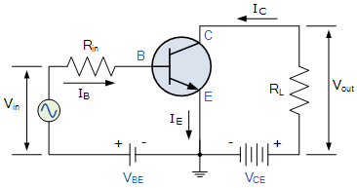
COMMON-EMITTER CIRCUIT
Common-emitter: has both voltage and current gain.
Since I_{E} = I_{B} + I_{C}, the the current flowing into the transistor must equal the current flowing out of the transistor.
The current gain of the common-emitter configuration is quite large as it is
This transistor configuration has a greater input impedance, current and power gain than that of the common-base configuration.
It is an inverting amplifier circuit, and thus its resulting output signal is 180º out of phase with the input voltage signal.

Slide 12

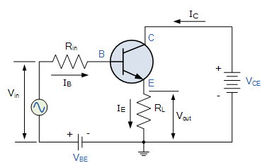
COMMON COLLECTOR
Common-collector: has current gain but no voltage gain.
Since I_{E} = I_{B} + I_{C}, the the current flowing into the transistor must equal the current flowing out of the transistor.
The current gain is given by
The common collector configuration is non-inverting and as such, the input and output voltages are in-phase.

Slide 13
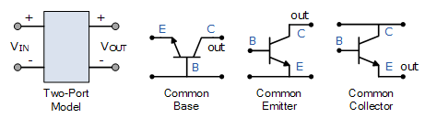
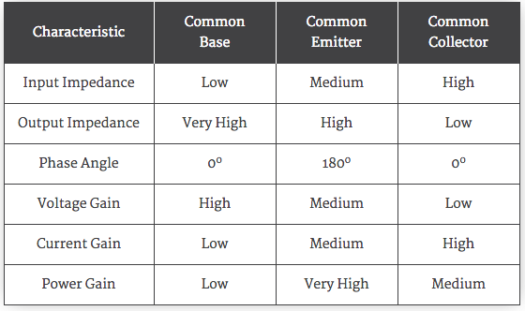
BJT CONFIGURATION SUMMARY

